Slide 1
3.1: Review of GLMs and GLMMs

Slide 2
How do we estimate things?
Specify a model
Function generating predictions
Identify plausible values for any unknown parameters
Maximize probability of observations given function
Assess uncertainty
Explore function around plausible values

Slide 3
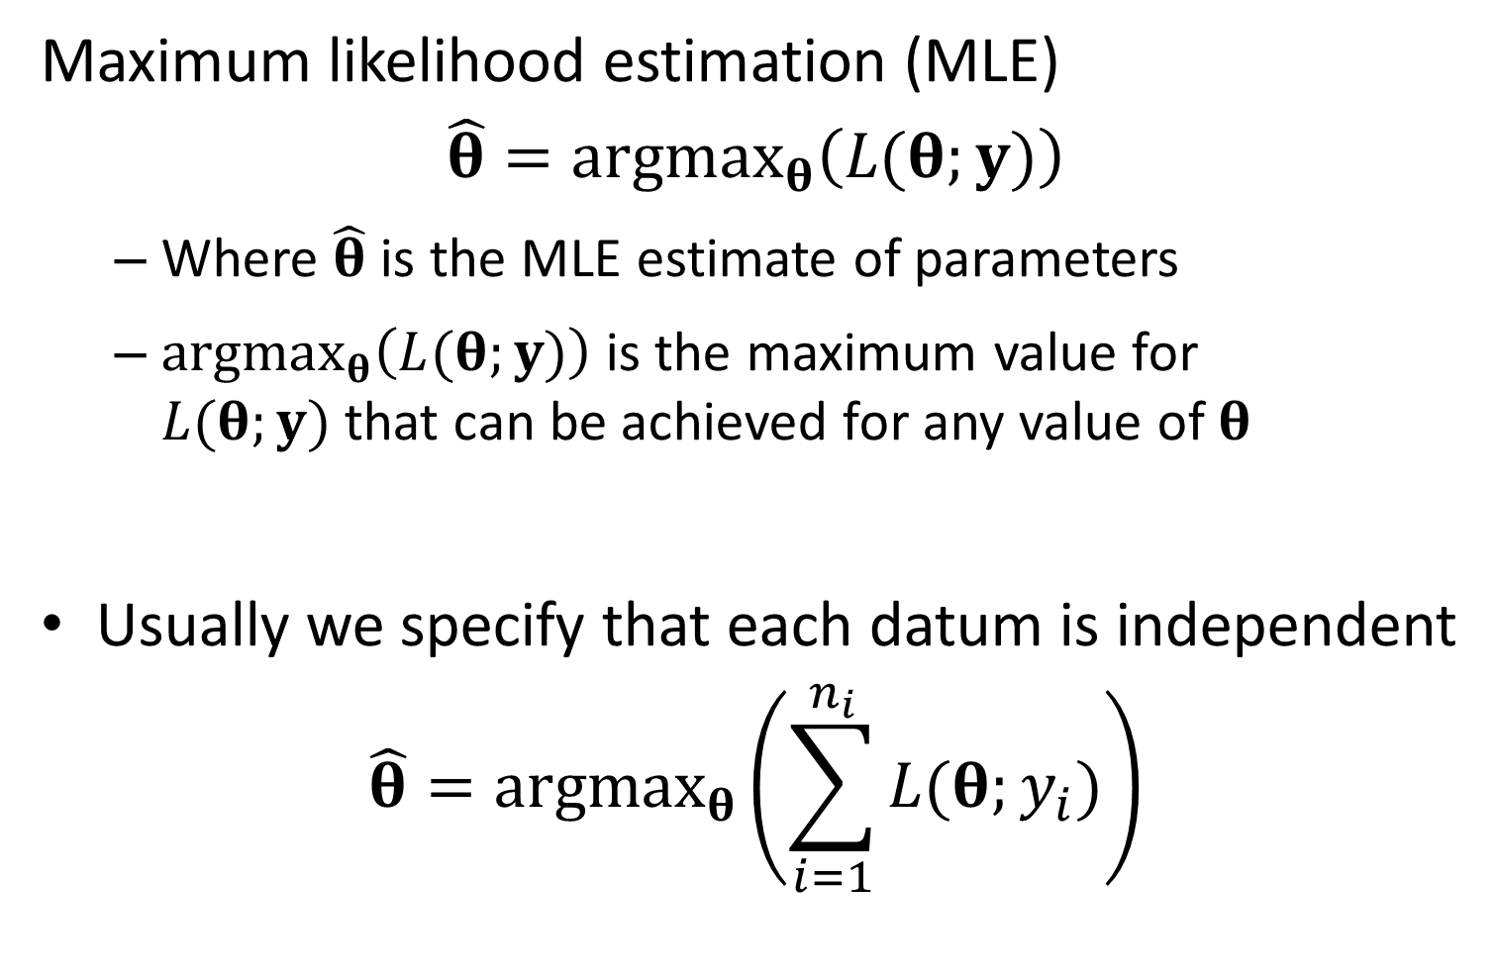
Maximum likelihood estimation (MLE)
$$\hat{θ}=argmax_{θ}\left(L(θ;y)\right)$$
Where $\hat{θ}$ is the MLE estimate of parameters
$argmax_{θ}\left(L(θ;y)\right)$is the maximum value for $L(θ;y)$that can be achieved for any value of $θ$
Usually we specify that each datum is independent
$$\hat{θ}=argmax_{θ}\left(\sum_{i=1}^{n_{i}}{L(θ;y_{i})}\right)$$

Slide 4
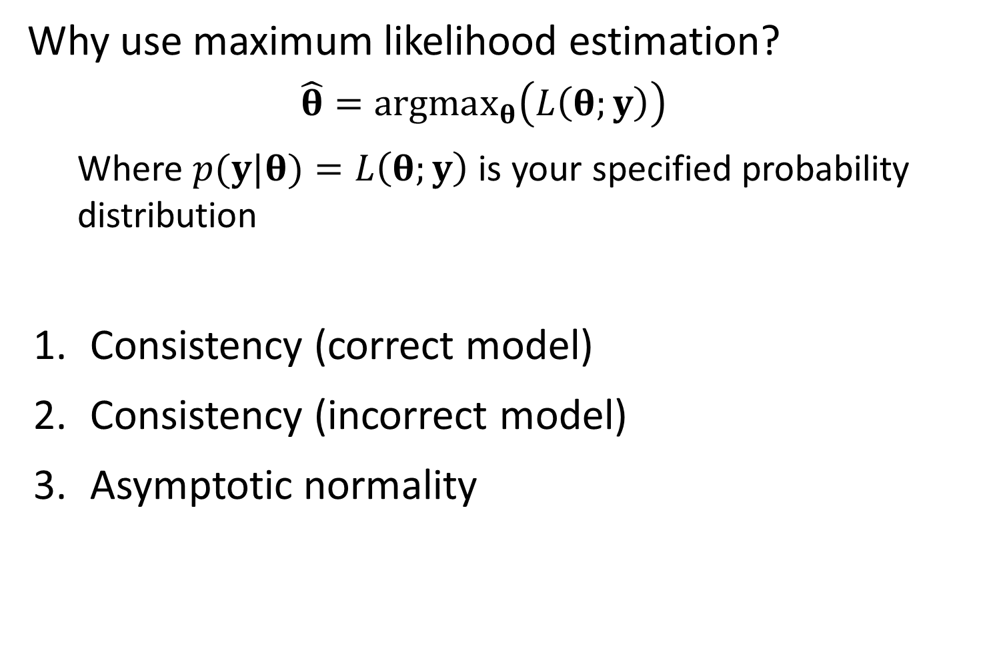
Why use maximum likelihood estimation?
$$\hat{θ}=argmax_{θ}\left(L\left(θ;y\right)\right)$$
Where $p(y|θ)=L\left(θ;y\right)$ is your specified probability distribution
Consistency (correct model)
Consistency (incorrect model)
Asymptotic normality

Slide 5
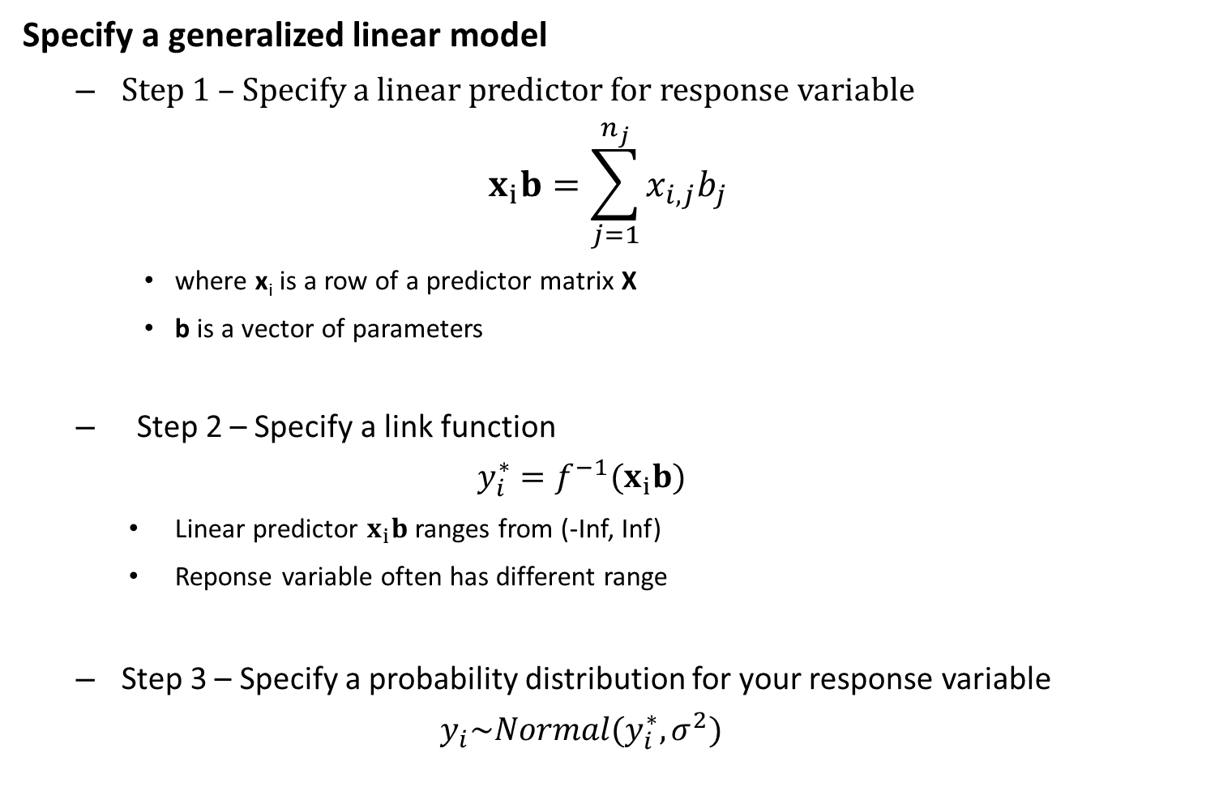
Specify a generalized linear model
Step 1 – Specify a linear predictor for response variable
$$x_{i}b=\sum_{j=1}^{n_{j}}{x_{i,j}b_{j}}$$
where x_{i} is a row of a predictor matrix X
b is a vector of parameters
Step 2 – Specify a link function
$$y_{i}^{∗}=f^{−1}(x_{i}b)$$
Linear predictor $x_{i}b$ ranges from (-Inf, Inf)
Reponse variable often has different range
Step 3 – Specify a probability distribution for your response variable
$$y_{i}\sim Normal(y_{i}^{∗},σ^{2})$$

Slide 6
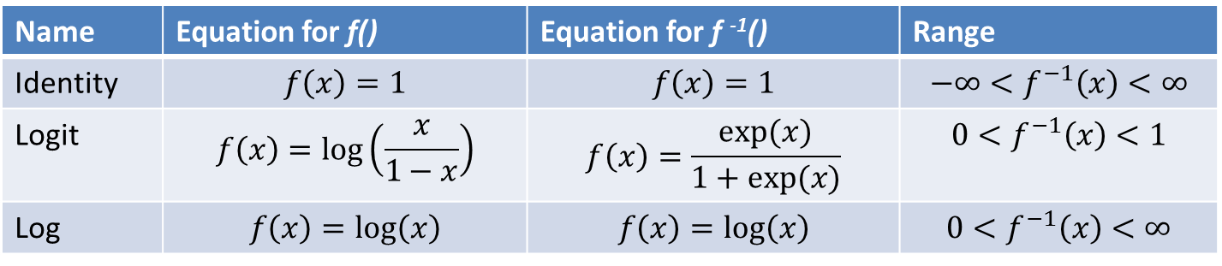
Common link functions
Why use link functions
Restrict range for variable
Help to interpret parameters
E.g., if using a log-link, then a 0.1 increase in predictors causes a 10% increase in the response
Name | Equation for f() | Equation for f ⁻¹() | Range
Identity | $$f\left(x\right)=1$$ | $$f\left(x\right)=1$$ | $$−∞<f^{−1}\left(x\right)<∞$$
Logit | $$f\left(x\right)=log⁡\left(\frac{x}{1−x}\right)$$ | $$f\left(x\right)=\frac{exp⁡(x)}{1+exp⁡(x)}$$ | $$0<f^{−1}\left(x\right)<1$$
Log | $$f\left(x\right)=log⁡\left(x\right)$$ | $$f\left(x\right)=log⁡\left(x\right)$$ | $$0<f^{−1}\left(x\right)<∞$$

Slide 7
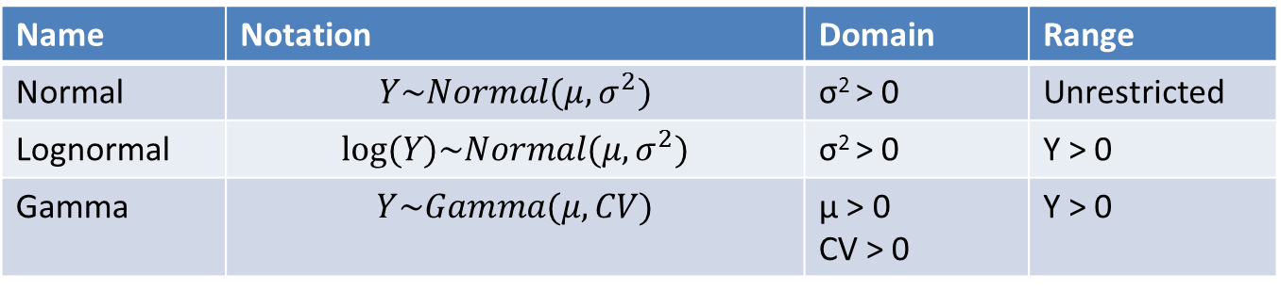
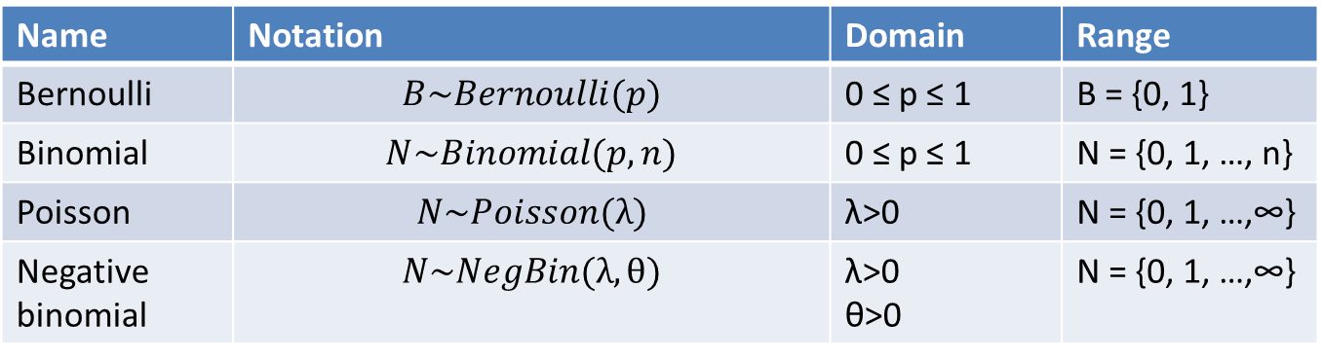
Common distributions for data
Discrete
Continuous
Name | Notation | Domain | Range
Bernoulli | $$B\sim Bernoulli(p)$$ | 0 ≤ p ≤ 1 | B = {0, 1}
Binomial | $$N\sim Binomial(p,n)$$ | 0 ≤ p ≤ 1 | N = {0, 1, …, n}
Poisson | $$N\sim Poisson(λ)$$ | λ>0 | N = {0, 1, …,∞}
Negative binomial | $$N\sim NegBin(λ,θ)$$ | λ>0 θ>0 | N = {0, 1, …,∞}
Name | Notation | Domain | Range
Normal | $$Y\sim Normal(μ,σ^{2})$$ | σ² > 0 | Unrestricted
Lognormal | $$log⁡(Y)\sim Normal(μ,σ^{2})$$ | σ² > 0 | Y > 0
Gamma | $$Y\sim Gamma(μ,CV)$$ | μ > 0 CV > 0 | Y > 0

Slide 8
How to chose a distribution for data?
Choice 1 – is it continuous or discrete?
Continuous: normal, lognormal, beta, gamma
Discrete: Bernoulli, binomial, poisson, negative binomial
Choice 2 – what is the range of possible values?
E.g., if discrete:
If is is 0 or 1, then its Bernoulli
If its between 0 and N, where N is the number of trials, then its Binomial
Choice 3 – How flexible do you want it?

Slide 9
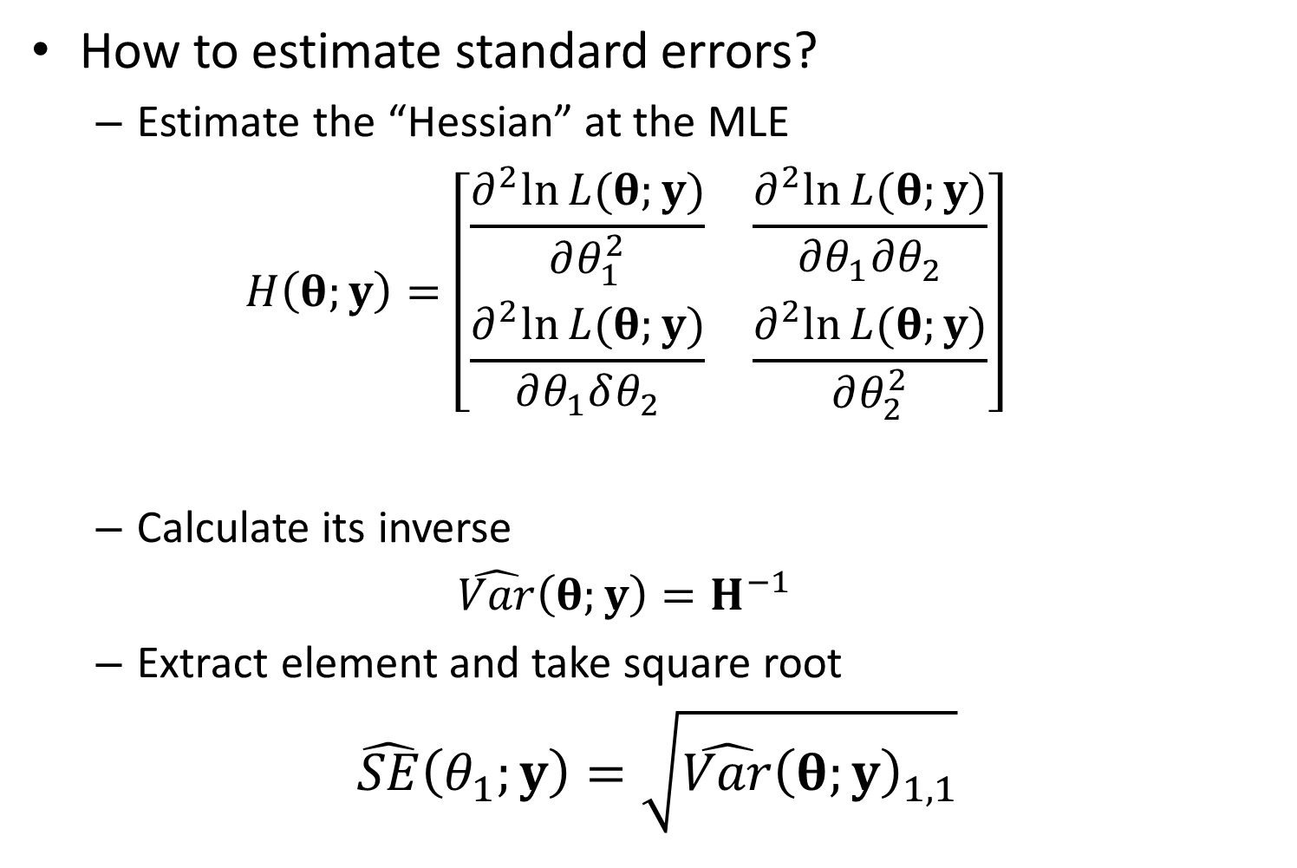
How to estimate standard errors?
Estimate the “Hessian” at the MLE
$$H\left(θ;y\right)=\left[\begin{matrix}\frac{∂^{2}ln⁡L(θ;y)}{∂θ_{1}^{2}} & \frac{∂^{2}ln⁡L(θ;y)}{∂θ_{1}∂θ_{2}} \\ \frac{∂^{2}ln⁡L(θ;y)}{∂θ_{1}δθ_{2}} & \frac{∂^{2}ln⁡L(θ;y)}{∂θ_{2}^{2}}\end{matrix}\right]$$
Calculate its inverse
$$\hat{Var}\left(θ;y\right)=H^{−1}$$
Extract element and take square root
$$\hat{SE}\left(θ_{1};y\right)=\sqrt{\hat{Var}{\left(θ;y\right)}_{1,1}}$$

Slide 10
Definitions
Term | Definition
Random effect | Coefficient that is “exchangeable” with one or more other coefficients
Hyperdistribution | Distribution for “exchangeable” random effects
Exchangeable | No information is available to distinguish between residual variability in random effects
Fixed effect | Coefficient that is not exchangeable with others, and which hence is estimated without a hyperdistribution
Mixed-effect model | Model with both fixed and random effects

Slide 11
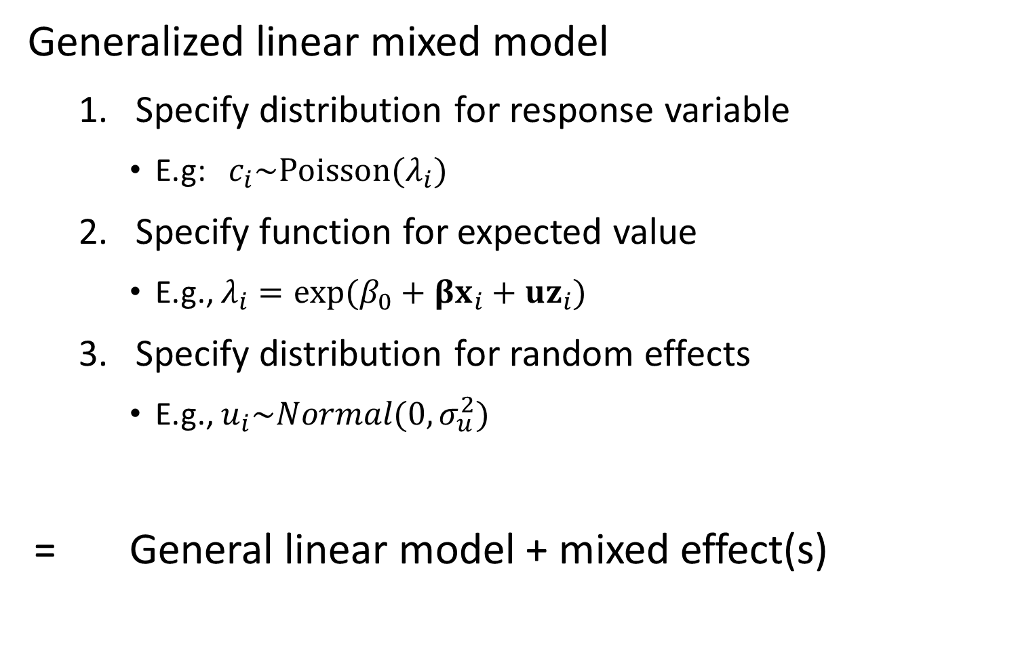
Generalized linear mixed model
Specify distribution for response variable
E.g: $c_{i}\sim Poisson(λ_{i})$
Specify function for expected value
E.g., $λ_{i}=exp⁡(β_{0}+βx_{i}+uz_{i})$
Specify distribution for random effects
E.g., $u_{i}\sim Normal(0,σ_{u}^{2})$
= General linear model + mixed effect(s)

Slide 12
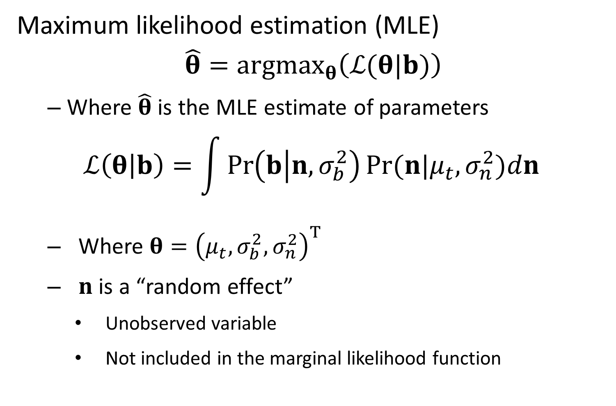
Maximum likelihood estimation (MLE)
$$\hat{θ}=argmax_{θ}\left(ℒ(θ|b)\right)$$
Where $\hat{θ}$ is the MLE estimate of parameters
$$ℒ\left(θ | b\right)=\int{\operatorname{Pr}\left(b | n,σ_{b}^{2}\right)Pr⁡(n|μ_{t},σ_{n}^{2}})dn$$
Where $θ={\left(μ_{t},σ_{b}^{2},σ_{n}^{2}\right)}^{T}$
$n$ is a “random effect”
Unobserved variable
Not included in the marginal likelihood function

Slide 13
Maximum likelihood estimation (MLE)
i.e., must “integrate” across random effects
They are never directly observed
They don’t count as “parameters” exactly
Random effects help to calculate the marginal likelihood of parameters
Fixed effects can be estimated without ever interpreting random effects

Slide 14
Say we’re sampling fishes near Seattle
Know from GIS maps that we have 120 streams
Can only conduct 60 samples
Problems
Can’t sample every stream!
Have to deal with measurement errors
Might have covariates to include

Slide 15
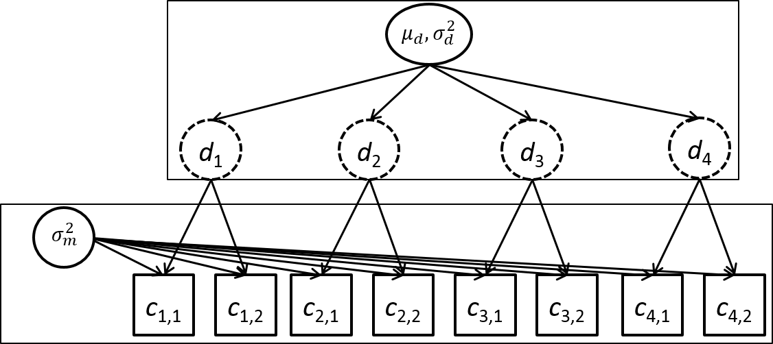
Think about a hierarchy of parameters

Slide 16
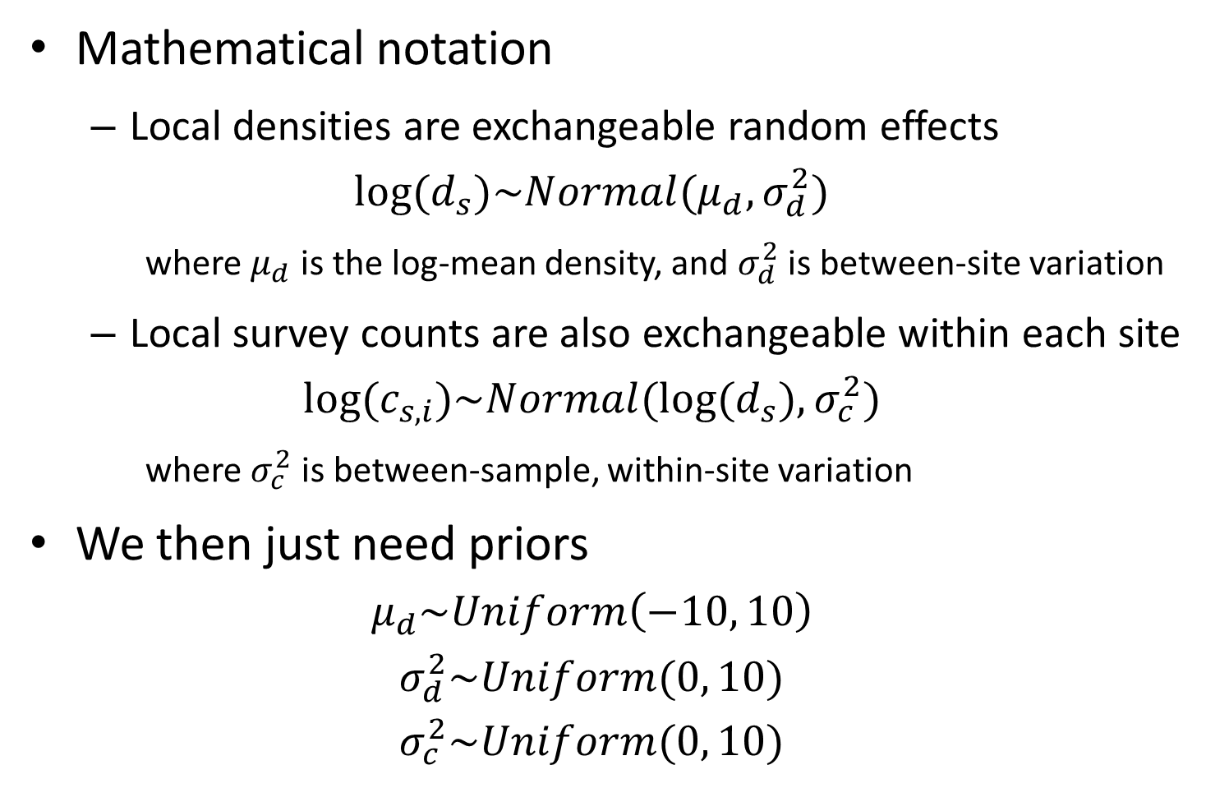
Mathematical notation
Local densities are exchangeable random effects
$$log⁡(d_{s})\sim Normal(μ_{d},σ_{d}^{2})$$
where $μ_{d}$ is the log-mean density, and $σ_{d}^{2}$ is between-site variation
Local survey counts are also exchangeable within each site
$$log⁡(c_{s,i})\sim Normal(log⁡(d_{s}),σ_{c}^{2})$$
where $σ_{c}^{2}$ is between-sample, within-site variation
We then just need priors
$$μ_{d}\sim Uniform\left(−10, 10\right)$$
$$σ_{d}^{2}\sim Uniform(0, 10)$$
$$σ_{c}^{2}\sim Uniform(0, 10)$$

Slide 17
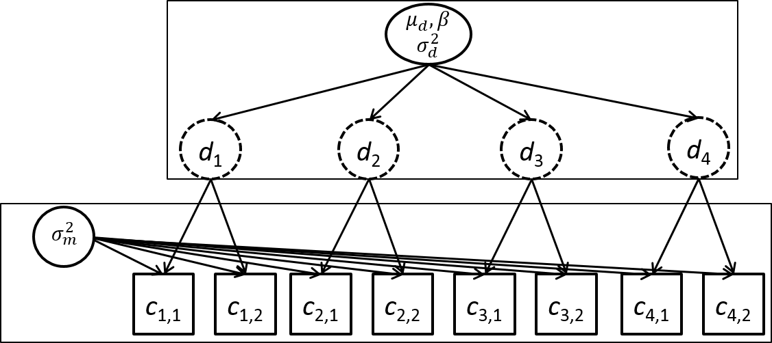

What if there’s a covariate?
Assume its measured at all chosen sites
Estimate its effect!
$$log⁡(d_{s})\sim Normal(μ_{d}+βx_{s},σ_{d}^{2})$$

Slide 18
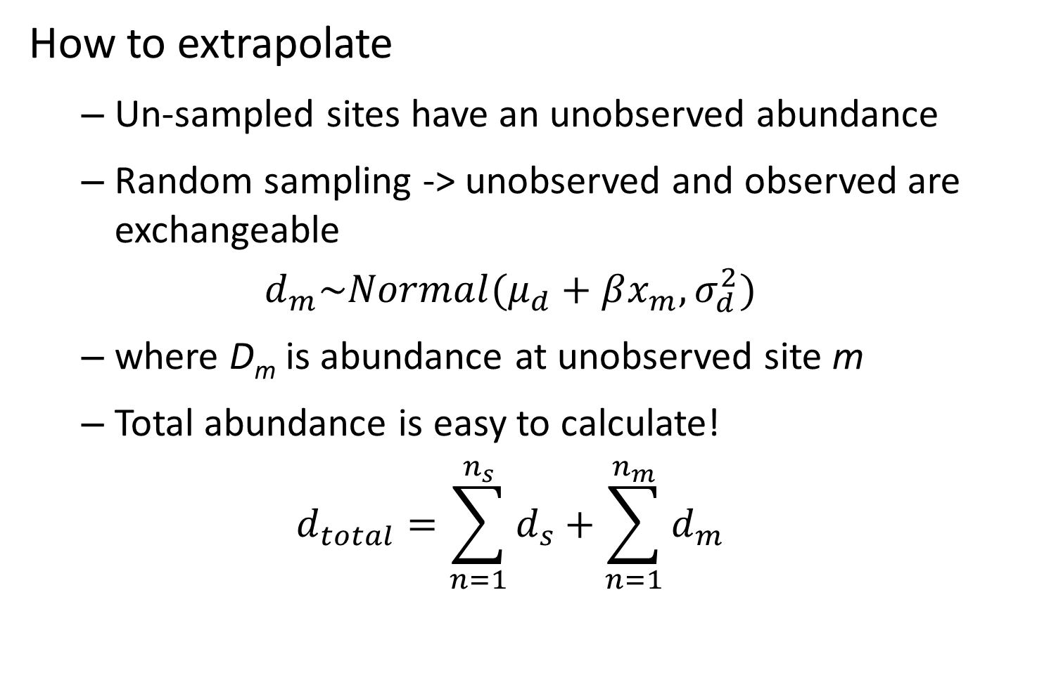
How to extrapolate
Un-sampled sites have an unobserved abundance
Random sampling -> unobserved and observed are exchangeable
$$d_{m}\sim Normal(μ_{d}+βx_{m},σ_{d}^{2})$$
where D_{m} is abundance at unobserved site m
Total abundance is easy to calculate!
$$d_{total}=\sum_{n=1}^{n_{s}}{d_{s}}+\sum_{n=1}^{n_{m}}{d_{m}}$$

